Slide 1
Deep Dreaming on Audio
October 13, 2016
Marko Stamenovic

Slide 2
Convolutional Neural Networks
Deep neural networks
Each convolutional layer has 10s-100s image filters
Shallow layers learn abstract features
Deeper layers learn more semantically relevant features

Slide 3
Inducing hallucination
Pull a layer out of the convnet
Run an image through it
Maximize mean of the weights, rinse, repeat
+
+

Slide 4
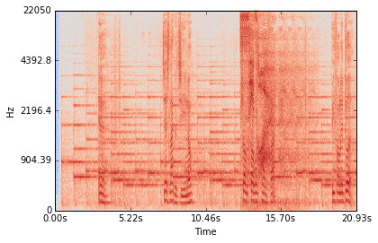
Audio Spectrogram
STFT

Slide 5
A SPECTROGRAM IS AN NxNx1 MATRIX
AN IMAGE IS AN NxNx3 MATRIX (RGB)….....
.....HMMMMM

Slide 6
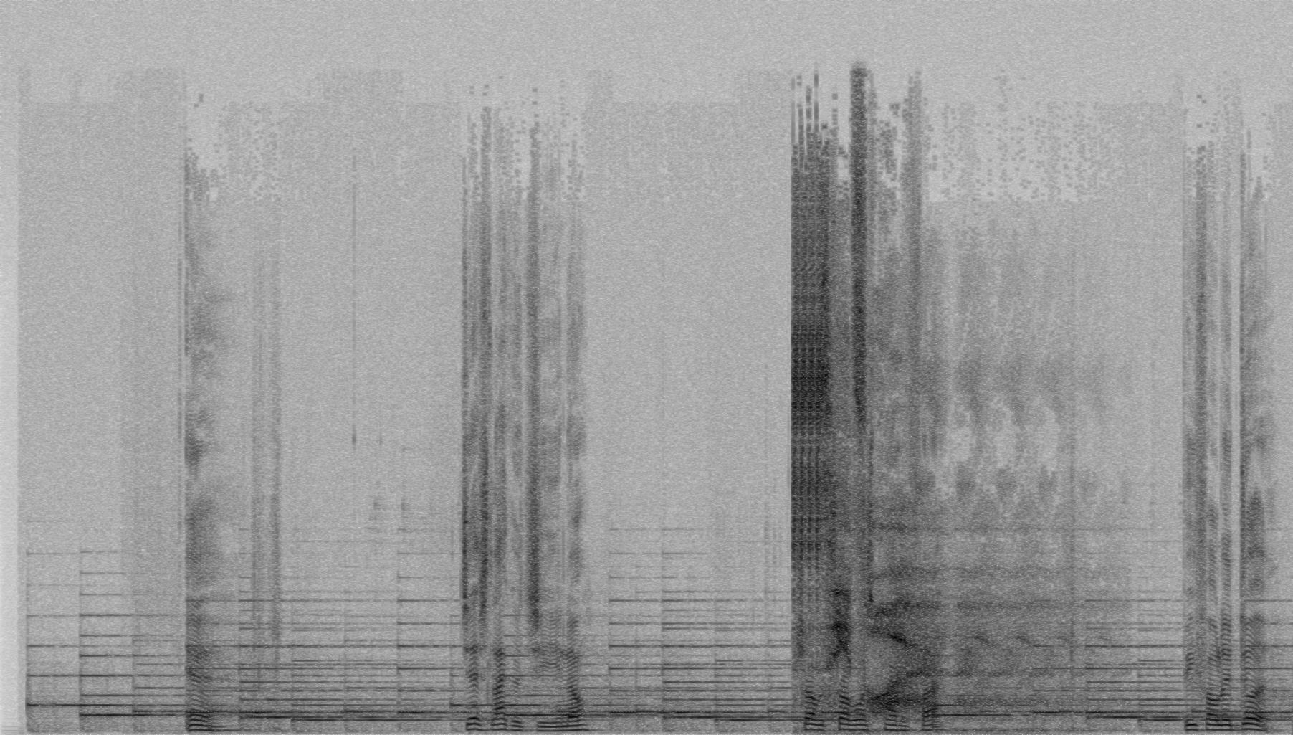
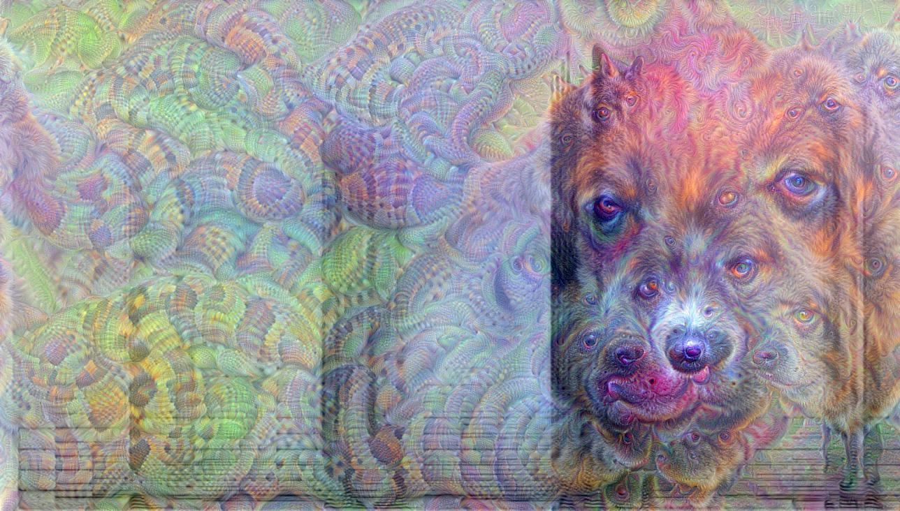
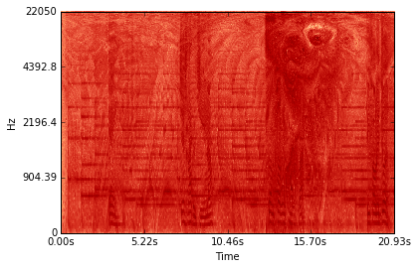
Trippy mane!

Slide 7
Thanks!
Any questions ?
You can find me at
markostam@gmail.com

